Slide 1
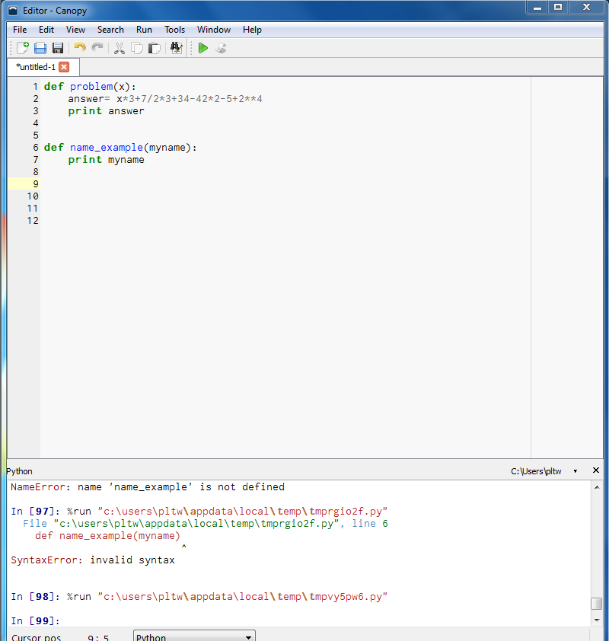

Using Canopy Developer’s Tool for Python Programming

Slide 2
If x =7, what is the answer?
x * 3 + 7 / 2 * 3 +3 4 – 42 * 2 – 5 + 2 ** 4

Slide 3


Slide 4


Slide 5
If x =3, what is the Answer?
x * 3 + 7 / 2 * 3 +3 4 – 42 * 2 – 5 + 2 ** 4

Slide 6
If x =5, what is the Answer?
x * 3 + 7 / 2 * 3 +3 4 – 42 * 2 – 5 + 2 ** 4

Slide 7
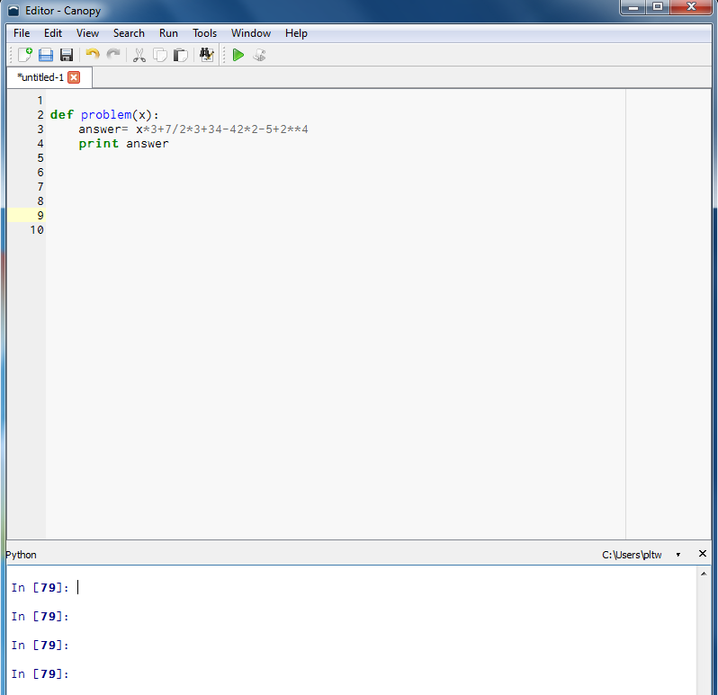

Slide 8
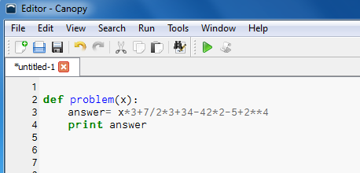

Slide 9
Parts of a function:
1. def (stands for “Define”)
2. Function name
3. Parameters (zero to a lot!)
4. Colon
5. Function body
Function name
Parameters
def example_func(x):
return x**2
Colon
def indicates
a function
Function body

Slide 10
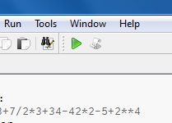
Hit the Green arrow to load the function (it operates much like the enter key)
You should get a clean line (no errors identified) below.

Slide 11
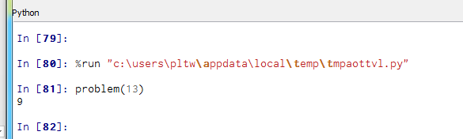
Call the function using the argument, i.e.,
In [ ]: problem (13)

Slide 12
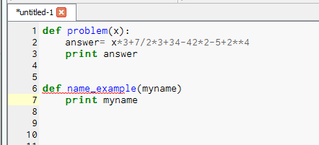

Slide 13


Slide 14
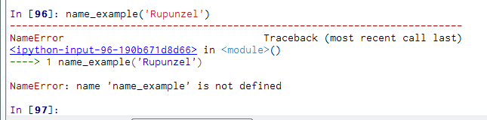

Slide 15
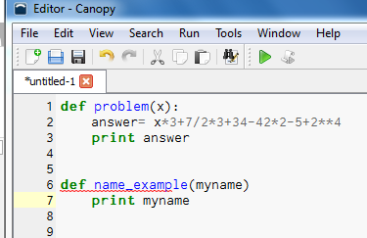
Green Arrow!!

Slide 16
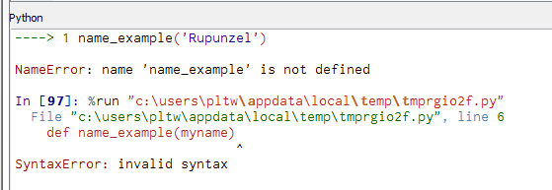

Slide 17
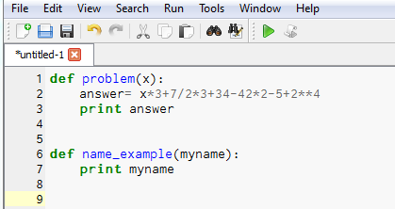
My code was missing the semi-colons!

Slide 18

Now a clean run!

Slide 19


Slide 20
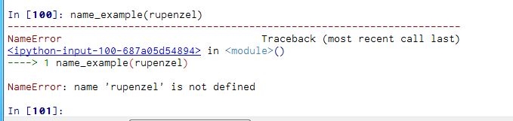
@$#@^% !!!!! I messed up again!!!!
What is wrong?

Slide 21
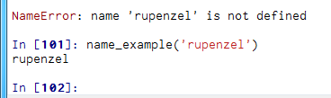
No quote marks. Good now! Hooray!!

Slide 22
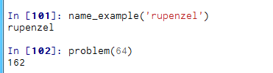
The problem function is still active and we call it whenever we want.

Slide 23
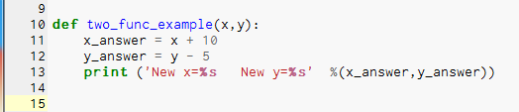

Slide 24


Slide 25
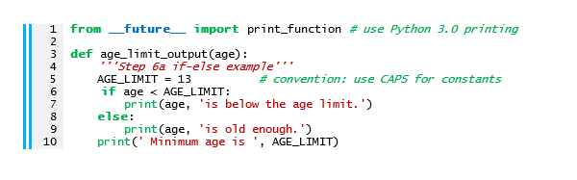
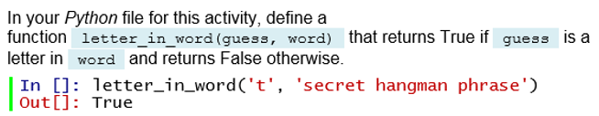
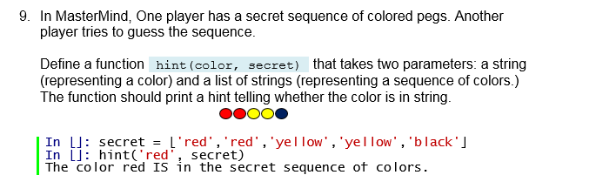
Activity 1.3.3 Branching and Output
6.
Delete this line
8.
Turn this in (Hangman).
Screen shot or snipping tool.
Turn this in (Mastermind).
Screen shot or snipping tool.

Slide 26
How to play mastermind
http://www.youtube.com/watch?v=OPeBUDXKGqA

Slide 27
def problem(x):
answer= x*3+7/2*3+34-42*2-5+2**4
print answer
print ('answer = %s' % answer)
def namefunc(myname):
print myname
print ('hello %s' % myname)
def two_func_name(last, first):
print ('Hello %s %s' %(first, last))
def two_func_number(x, y):
x_answer = x + 10
y_answer = y - 5
print ('New x = %s' ' New y = %s' %(x_answer,y_answer))

